Slide 1
PERSON
DETECTION
Pretrained Model - TF Lite
19AIE211
Introduction To Computer Networks

Slide 2
GROUP MEMBERS:
RAJANEESHWAR [19027]
LAKSHAYA K [19039]
GOKUL PRAZATH [19062]
VASUDEVAN KM [19067]

Slide 3
OBJECTIVE:
Convert a pre-trained model to Tensorflow lite
Perform person detection

Slide 4
TABLE OF CONTENTS
01
02
03
04
OBTAINING THE PRETRAINED MODEL
QUANTISATION
IMPLEMENTATION
CONCLUSION

Slide 5
01
OBTAINING THE PRETRAINED MODEL

Slide 6
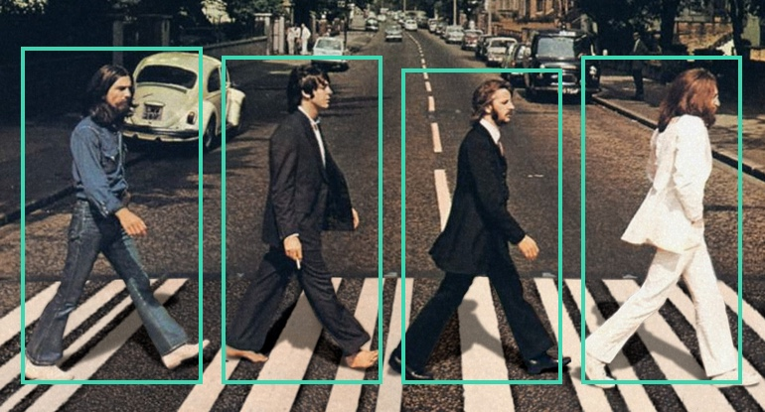
PERSON
DETECTION
Locating all instances of human beings present in an image
Commonly accomplished By:
searching all locations in the image
comparing a small area at each location with known templates or patterns of people

Slide 7
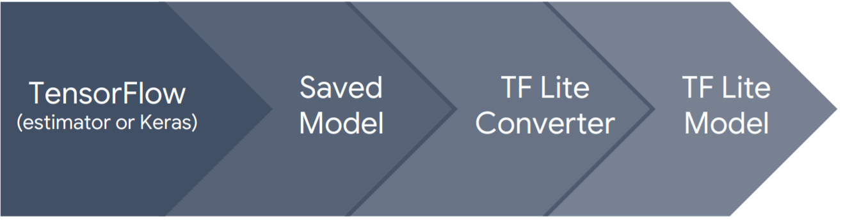
FLOWGRAPH:

Slide 8
TensorFlow Pretrained Models:
CenterNet
EfficientDet
SSD MobileNet
ResNet
R-CNN
ExtremeNet
SSD MobileNet
CHOSEN MODEL: SSD MOBILENET
Notes:
The TensorFlow model zoo is a collection of pretrained object detection models. These are some of the models that are available. Currently only SSD models are supported by the TensorFlow lite API so we’ll be using the SSD mobilenet model for our project.
https://heartbeat.fritz.ai/real-time-object-detection-using-ssd-mobilenet-v2-on-video-streams-3bfc1577399c

Slide 9
SSD MobileNet V2
Object Detection Model
Trained on the COCO 2017 dataset
Model created using Object Detection API
Training | 118K images / 18GB
Validation | 5K images / 1GB
Testing | 41K / 6GB
Classes: 90 labels
NOTE: Since the pretrained models available are for object detection, it will be converted for person detection in the later steps.

Slide 10
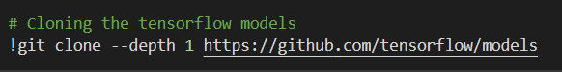
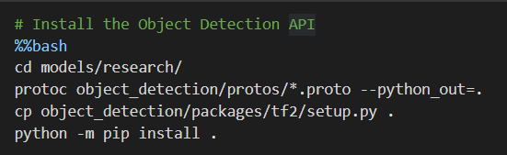
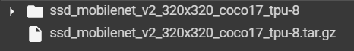
Step 1: Obtaining the Model
Notes:
The first step of the process is to obtain the model.
So firstly we’ll be cloning the tensorflow models from github using the the gitclone command.
Next, we’ll be installing the object detection API.
Then we’ll be downloading the inbuilt SSD MobileNet V2 model using wget. Since the format will be that of a zipped file, we’ll extract it using the tar command.
This is the output in our google colab file after running the commands. We have the zipped and unzipped versions of the SSD model.

Slide 11
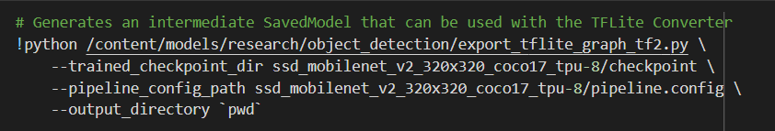
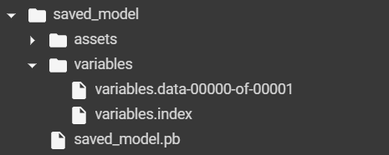
Step 2: Export TFLite inference graph
Notes:
In order to convert the pretrained model to tensorflow lite, we need to generate an intermediate savedmodel. To do this, we’ll be accessing a Python file called export tflte graph 2 that we got during the installation of the Object Detection API.
The parameters of this file is the directory to the checkpoint of our model. Checkpoints are used to capture the exact value of all parameters used by a model.
Next we’ll be giving the path of the pipeline configuration. All the settings and required information for training the model and evaluating is given in the pipeline.config file.
Then we’ll be defining our output directory as our current working directory by giving pwd.
The output is a folder named saved_model. We have an assets folder which typically contains files used by TensorFlow, for example text files used to initialize vocabulary tables. It is unused in our case so the folder is empty.
The variables folder contains 2 files, the variables.data file contains the model's weights and the variables.index file indicates where the weights are stored.

Slide 12
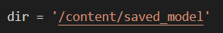
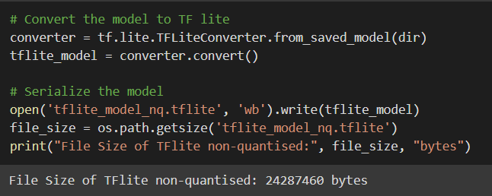
Step 3: Convert to TFLite
Notes:
The next step is to convert to tensorflow lite. We’ll be storing the path to our saved model in the variable dir.
Then we’ll be using the tensorflow convertor to convert our saved model and store it in a variable named tflite_model.
We’ll then write this into a file and get the size of it in bytes. The size of the converted TFLite file can be seen here.

Slide 13
02
QUANTISATION

Slide 14
IMPROVING THE MODEL: MAIN REASONS
.
LATENCY MEMORY UTILIZATION POWER CONSUMPTION
Makes model smaller (smaller memory footprint)
Makes inference more efficient
Makes model work with low precision
Uses less energy in inference
Notes:
Inference efficiency is a critical concern when deploying machine learning models because of latency, memory utilization, and in many cases power consumption.
Particularly on edge devices, such as mobile and Internet of Things (IoT), resources are further constrained, and model size and efficiency of computation become a major concern.

Slide 15
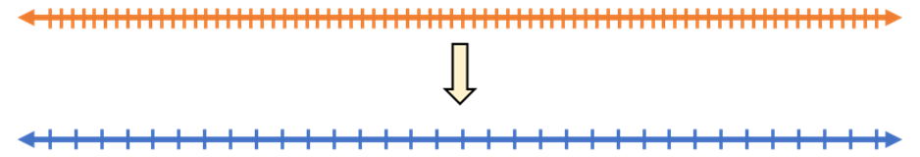
Low Precision:
Machines can only use a finite number of bits to represent infinite real numbers
Accuracy of representation: dependant by how many bits we use
Default: 32-bit
Quantization of the numbers: Numbers are discretized to some specific values, which we can then represent using integers instead of floating-point numbers.
Notes:
•Computers can only use a finite number of bits to represent infinite real numbers.
•The accuracy of representation is decided by how many bits we use
•32-bit floating point being the default for most applications, including deep learning.
•DNNs can work with smaller datatypes, with less precision, such as 8-bit integers
•Quantization of the numbers: Numbers are discretized to some specific values, which we can then represent using integers instead of floating-point numbers.

Slide 16
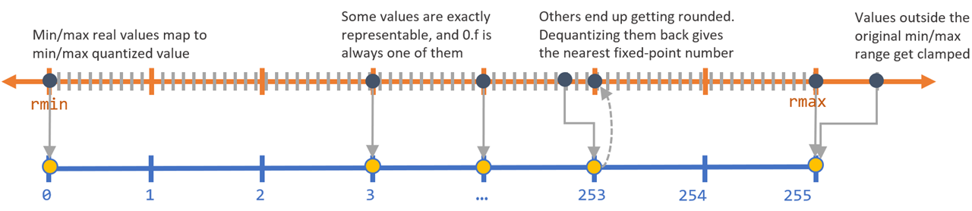
Quantization Scheme:

Slide 17
Types of Post-training Optimisation:
Dynamic range Quantization
Integer
Quantization
Float16
Quantization

Slide 18
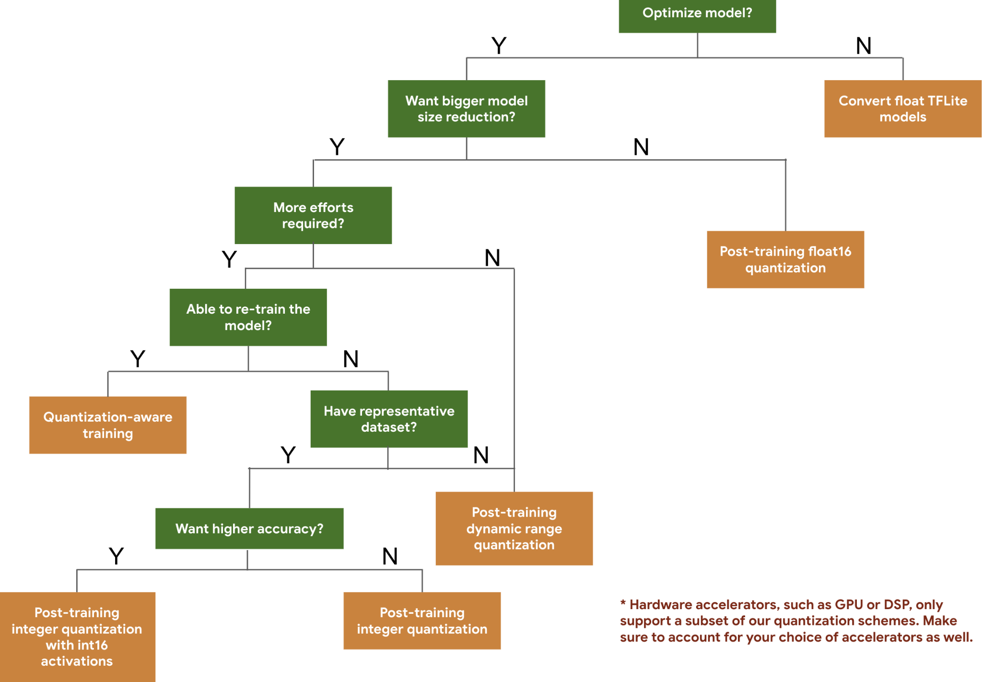
Since we won’t be re-training our model, we won’t be performing quantisation-aware training

Slide 19
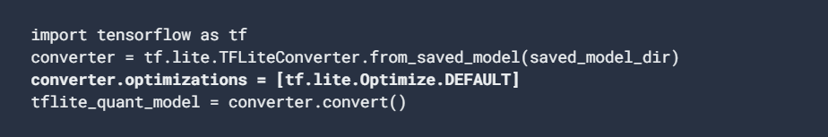
DYNAMIC RANGE QUANTIZATION:
Simplest form of post-training quantization
Conversion done once and cached to reduce latency
Float32 Point Weights
Int8 Weights
4x reduction in model size
Due to small size → Can’t run on GPU or TPU
Have to use a CPU for this purpose.
Notes:
It’s also possible to quantize dynamically – meaning that model weights get quantized into int8 format from float32 format (TensorFlow, n.d.). This means that your model will become 4 times smaller, or 25% of the original size.
At inference, weights are converted from 8-bits of precision to floating point and computed using floating-point kernels. This conversion is done once and cached to reduce latency.
To further improve latency, "dynamic-range" operators dynamically quantize activations based on their range to 8-bits and perform computations with 8-bit weights and activations. This optimization provides latencies close to fully fixed-point inference. However, the outputs are still stored using floating point so that the speedup with dynamic-range ops is less than a full fixed-point computation.
While models get smaller with dynamic range quantization, we lose the possibility of running our model for inference on a GPU or TPU. Instead, we’ll have to use a CPU for this purpose.

Slide 20
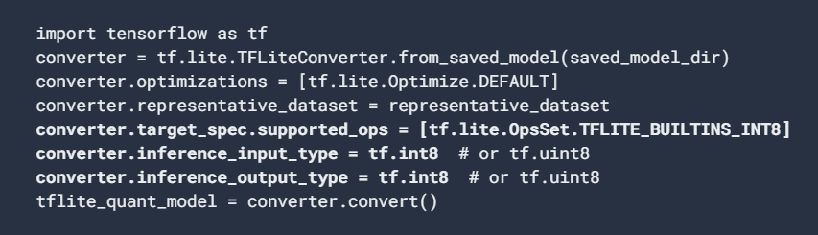
FULL INTEGER QUANTIZATION:
Trained Floating Point Model
8-Bit Signed Integers
4x reduction in model size
Greater CPU speed-ups
Ability to run on even fixed point hardware accelerators
Notes:
The full integer quantization enables users to take an already-trained floating-point model and fully quantize it to only use 8-bit signed integers (i.e. `int8`). By using this quantization scheme, we can get reasonable quantized model accuracy across many models without resorting to retraining a model with quantization-aware training. With this new tool, models will continue to be 4x smaller, but will see even greater CPU speed-ups. Fixed point hardware accelerators, such as Edge TPUs, will also be able to run these models.
For full integer quantization, we need to calibrate or estimate the range, (min, max) of all floating-point tensors in the model. Unlike constant tensors such as weights and biases, variable tensors such as model input, activations (outputs of intermediate layers) and model output cannot be calibrated unless we run a few inference cycles. As a result, the converter requires a representative dataset to calibrate them. This dataset can be a small subset of the training or validation data.
You can get further latency improvements, reductions in peak memory usage, and compatibility with integer only hardware devices or accelerators by making sure all model math is integer quantized.

Slide 21
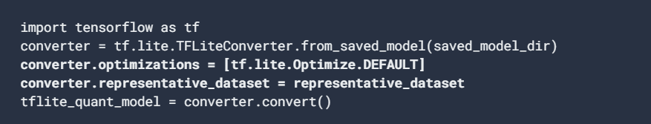
FLOAT FALLBACK QUANTIZATION:
In order to fully integer quantize a model, but use float operators when they don't have an integer implementation
Ensures that conversion occurs smoothly
Won’t be compatible with integer only devices
Input and output still remains float in order to have the same interface as the original float only model.
Notes:
The full integer quantization enables users to take an already-trained floating-point model and fully quantize it to only use 8-bit signed integers (i.e. `int8`). By using this quantization scheme, we can get reasonable quantized model accuracy across many models without resorting to retraining a model with quantization-aware training. With this new tool, models will continue to be 4x smaller, but will see even greater CPU speed-ups. Fixed point hardware accelerators, such as Edge TPUs, will also be able to run these models.
For full integer quantization, we need to calibrate or estimate the range, (min, max) of all floating-point tensors in the model. Unlike constant tensors such as weights and biases, variable tensors such as model input, activations (outputs of intermediate layers) and model output cannot be calibrated unless we run a few inference cycles. As a result, the converter requires a representative dataset to calibrate them. This dataset can be a small subset of the training or validation data.
You can get further latency improvements, reductions in peak memory usage, and compatibility with integer only hardware devices or accelerators by making sure all model math is integer quantized.

Slide 22
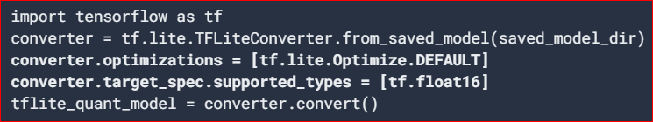
FLOAT16 QUANTIZATION:
32-bit Floats
16-bit Floats
2x reduction in model size
Negligible accuracy loss
Supports some delegates which can operate directly on float16 data → faster execution
Does not reduce latency as much as a quantization to fixed point math.
By default, a float16 quantized model will "dequantize" the weights values to float32 (only on CPU)
No dequantization on GPU delegate → can operate on float16
Notes:
The advantages of float16 quantization are as follows:
It reduces model size by up to half (since all weights become half of their original size).
It causes minimal loss in accuracy.
It supports some delegates (e.g. the GPU delegate) which can operate directly on float16 data, resulting in faster execution than float32 computations.
The disadvantages of float16 quantization are as follows:
It does not reduce latency as much as a quantization to fixed point math.
By default, a float16 quantized model will "dequantize" the weights values to float32 when run on the CPU. (Note that the GPU delegate will not perform this dequantization, since it can operate on float16 data.

Slide 23
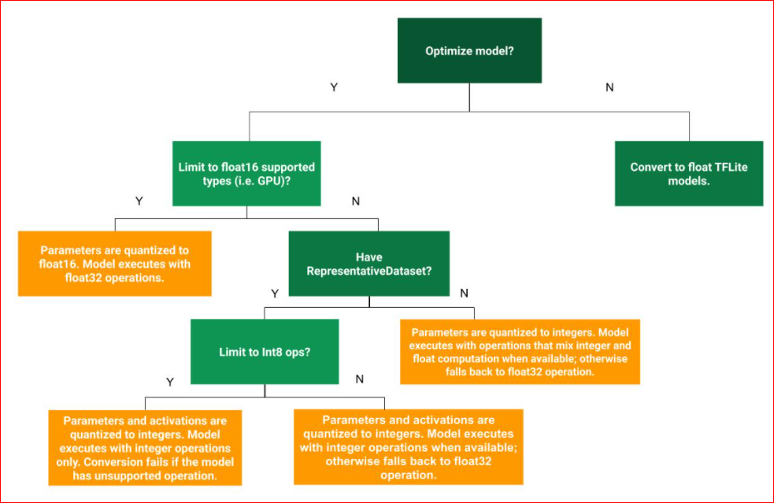
DECISION TREE:
Determining best post-training quantization method for a given use-case

Slide 24
Comparison:
Model | Dynamic Range | Full Integer | Float16
Size | 4x reduction | 4x reduction | 2x reduction
Speed-up | 2x-3x speedup | 3x+ speedup | GPU acceleration
Accuracy | Accuracy Loss | Smaller Accuracy Loss | Insignificant Accuracy Loss
Hardware | CPU | CPU, Edge TPU, Microcontrollers | CPU, GPU
Data Requirements | No data | Representative Sample | No data

Slide 25
03
DETECTION USING
TFLITE MODELS

Slide 26
Our Model:
Output:
Number of Detections
Detection Boxes
Detection Classes
Detection Scores
Input:
A three-channel image of variable size
Notes:
num_detections: a tf.int tensor with only one value, the number of detections [N].
detection_boxes: a tf.float32 tensor of shape [N, 4] containing bounding box coordinates in the following order: [ymin, xmin, ymax, xmax].
detection_classes: a tf.int tensor of shape [N] containing detection class index from the label file.
detection_scores: a tf.float32 tensor of shape [N] containing detection scores.

Slide 27

Brief Overview:
Class 1:
Non-Human
Class | 1
Confidence | 1
Human Count | 0

Slide 28
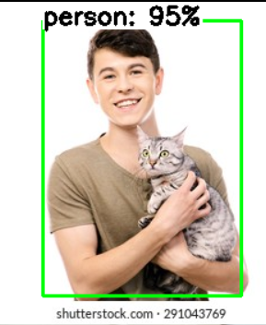
Class 0:
Human
Class | 0
Confidence | 0.95
Human Count | 1

Slide 29
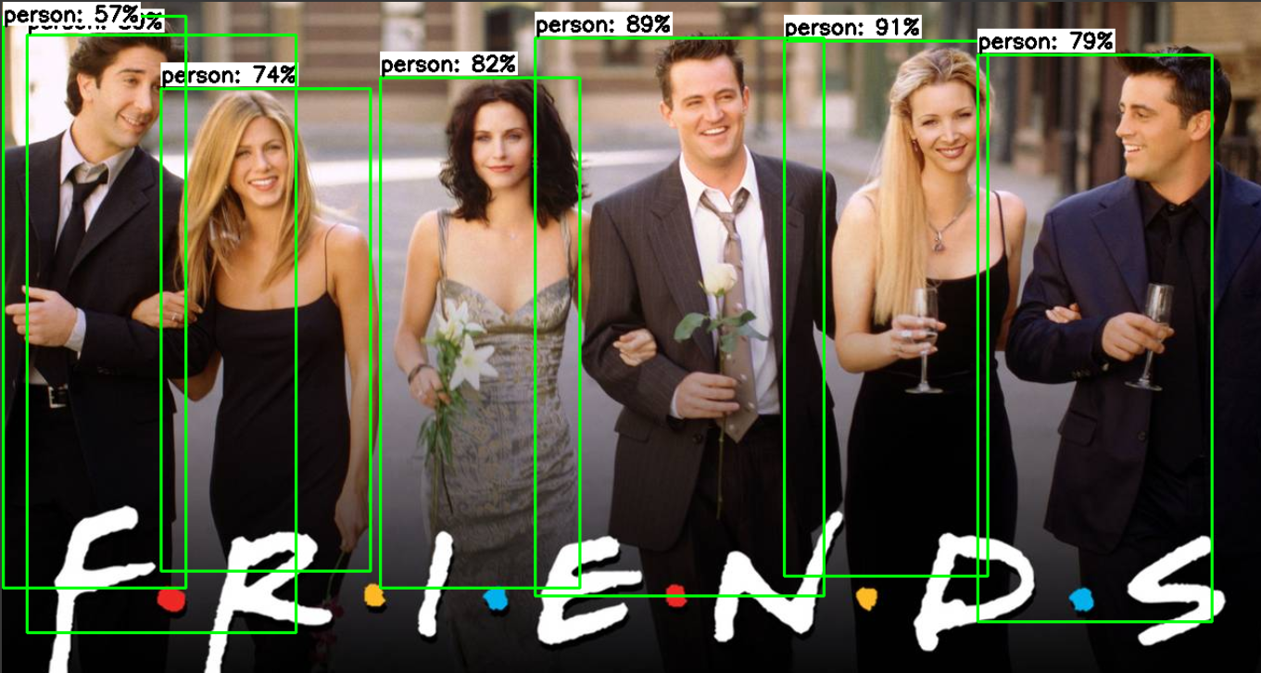
Class 0:
Human
Class | 0
Confidence | 0.91, 0.89, 0.82, 0.79, 0.74,0.59, 0.57
Human Count | 7

Slide 30
04
CONCLUSION

Slide 31
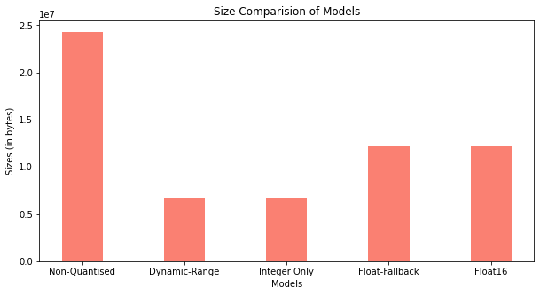
Comparing our models:

Slide 32
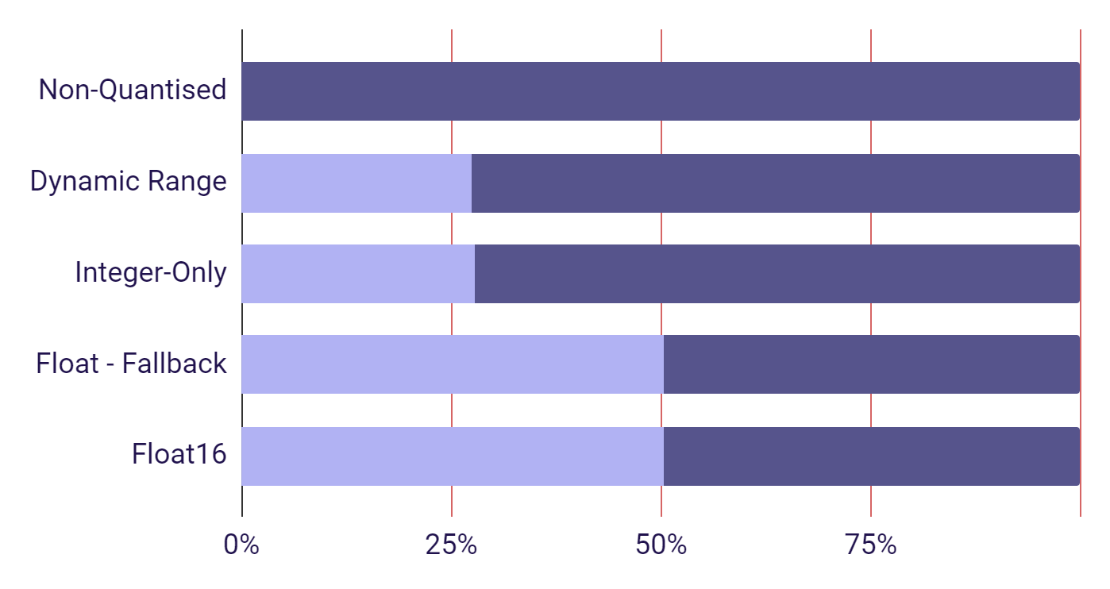
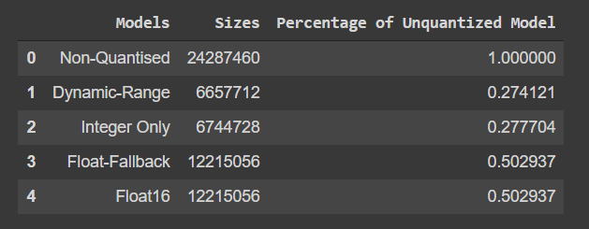
Verification:
Obtained:
Expected:
Model | Dynamic Range | Full Integer | Float16
Size | 4x reduction | 4x reduction | 2x reduction

Slide 33
THANK
YOU!

